Slide 1

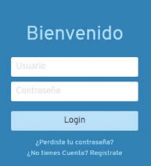
BIKES -MASTER

